Slide 1
Image Healer
Guide : Prof.R.LAKSHAPRIYA M.Sc., M.Phil
-By
M.VENKATESH (2020ITC039)

Slide 2
Abstract for Image Healer
Image healer has become an essential aspect of digital content creation, enabling users to enhance, modify, and present images in various formats. This abstract highlights a set of versatile image editing tools that cater to different requirements, including cropper, image to PDF changer, filters changer, and resizer.
An image healer toolkit is to provide users with tools and features to modify and enhance digital images . This can include basic tasks such as cropping and resizing, as well as advanced functions such as color correction, selective adjustments, and compositing multiple images. The goal is to help users achieve their desired visual results and express their creative vision through their images.

Slide 3
Introduction
Image healer tools have become essential in various fields, ranging from graphic design to personal photography. These tools empower users to enhance, manipulate, and transform images according to their creative vision and practical needs. In this introduction, we will explore five specific image healer tool:
Image Cropper
Image Resizer
Image Compressor
Image Filters Changer
Image To PDF Converter

Slide 4
Problem Definition
The problem that an image healer toolkit aims to solve is the need for an efficient and accessible means of modifying and enhancing digital images.
With the increasing importance of visual content in various industries, there is a growing demand for software that makes it easy for people with a range of skill levels to produce high-quality images.
The toolkit must provide a range of features that address common challenges in image editing, such as color correction, removing blemishes or distracting elements, and adjusting lighting and contrast.
At the same time, it must also be intuitive and user-friendly, so that users can quickly and easily perform the tasks they need to produce the desired results.

Slide 5
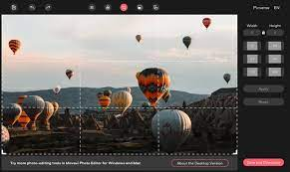
Image Cropper
Cropping an image is the removal of unwanted areas from a photograph or illustrated image. You might want to crop an image for several different reasons, including:
Eliminating visual distraction and highlighting your subject.
Improving a photo’s framing & accentuating its subject.
Changing the aspect ratio to prepare for sharing through different social media platforms.

Slide 6
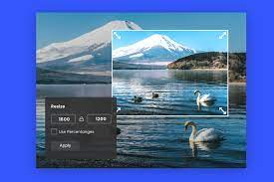
Image Resizer
Image resizing is used to convert an image of a given size to one of a different size. There exist different algorithms for resizing an image both in the spatial domain, as well as in the frequency domain where it is stored in compressed form. There are certain advantages of performing the resizing operation directly in the compressed domain.
The compressor tool helps reduce the size of an image file without significantly reducing its quality. This feature is useful when you need to upload an image to a website or send it via email, where large file sizes can cause issues.

Slide 7

Image Filters Adjustment
Image filters are algorithms that manipulate or enhance images to produce a desired effect or result. They can perform tasks such as removing noise, sharpening, blurring, changing brightness or contrast, adding special effects, and more. Image filters are widely used in photo editing software, computer vision, and other digital image processing applications.

Slide 8

Image To PDF Converter
An image to PDF converter is a software tool that converts one or more image files (such as JPEG, PNG, BMP, or GIF) into a single PDF document. This conversion allows the images to be viewed, shared, or printed as a single file rather than multiple separate image files.

Slide 9
Existing System
When using image healer tools such as a cropper, filters adjustments, image to PDF converter, and resizer, users may encounter several common problems. Here are some challenges that can be faced:
Loss of image quality
Limited Precision
Compatibility Issues
Complexity of Filter Adjustments
Inefficient Image to PDF Conversion
Distortion during Resizing
Performance and Speed

Slide 10
Proposed System
To solve the problems mentioned in the proposed system of image healer tools, the following approaches can be implemented:
Image Quality Preservation
Enhanced Precision and Control
Format Compatibility
Intuitive Filter Adjustment Interface
Optimize Image to PDF Conversion
Aspect Ratio Preservation in Resizing
Performance Optimization

Slide 11
Data Flow Diagram
Sign-Up
User
Enter Username & Password
Sign-Up
Authendication
False
True
Sign-Up Done
Login Page

Slide 12
Data Flow Diagram
Login
Login
Username
&
Passeord
False
Modules
True

Slide 13
Data Flow Diagram
Access The Modules
Home
Login
Img Resizer
Edit
Img Cropper
Img Filters Adjustment
Download
Img To PDF Converter
Logout

Slide 14
Database Design
Field Name | Field Type | Field Size | Constraints | Description
id | Integer | 5 | Primary Key,Auto increment,Not null | It is used to store the unique id
username | Varchar | 100 | Not Null | It is used to store the username
password | Varchar | 20 | Not Null | It is used to store the password

Slide 15
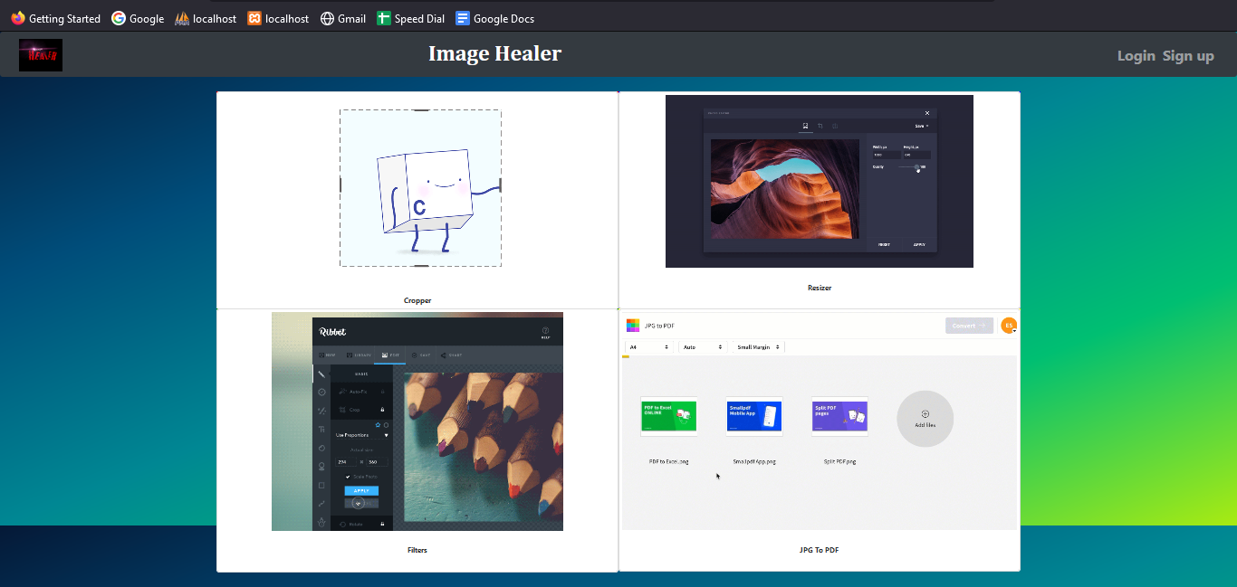
Screenshots
Home Page

Slide 16
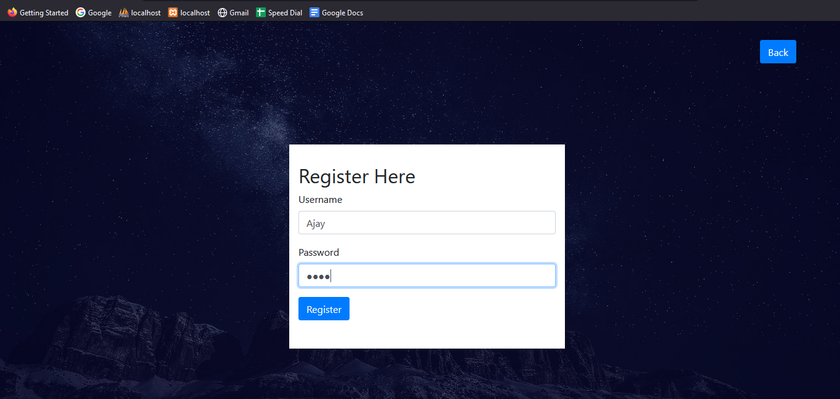
Screenshots
Register Page

Slide 17
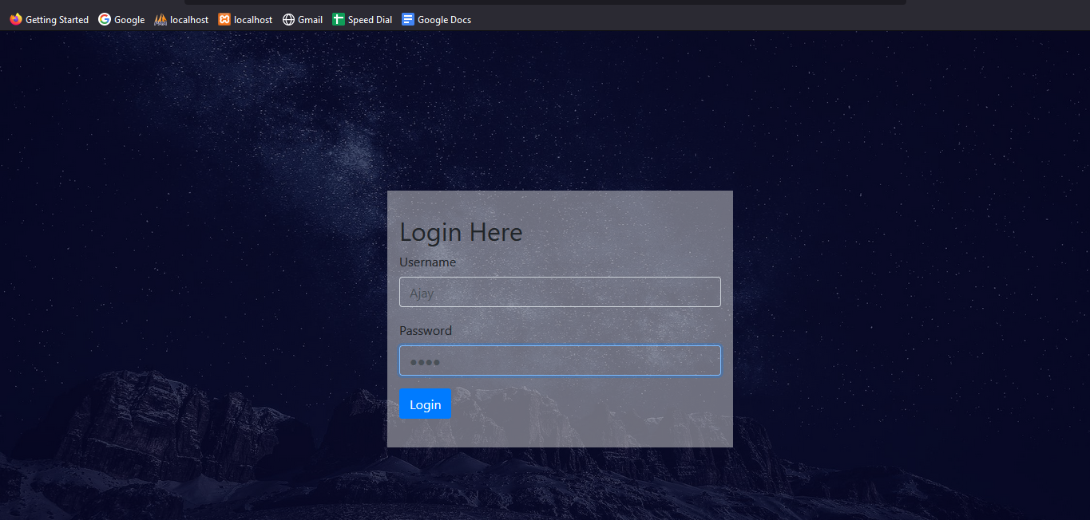
Screenshots
Login Page

Slide 18
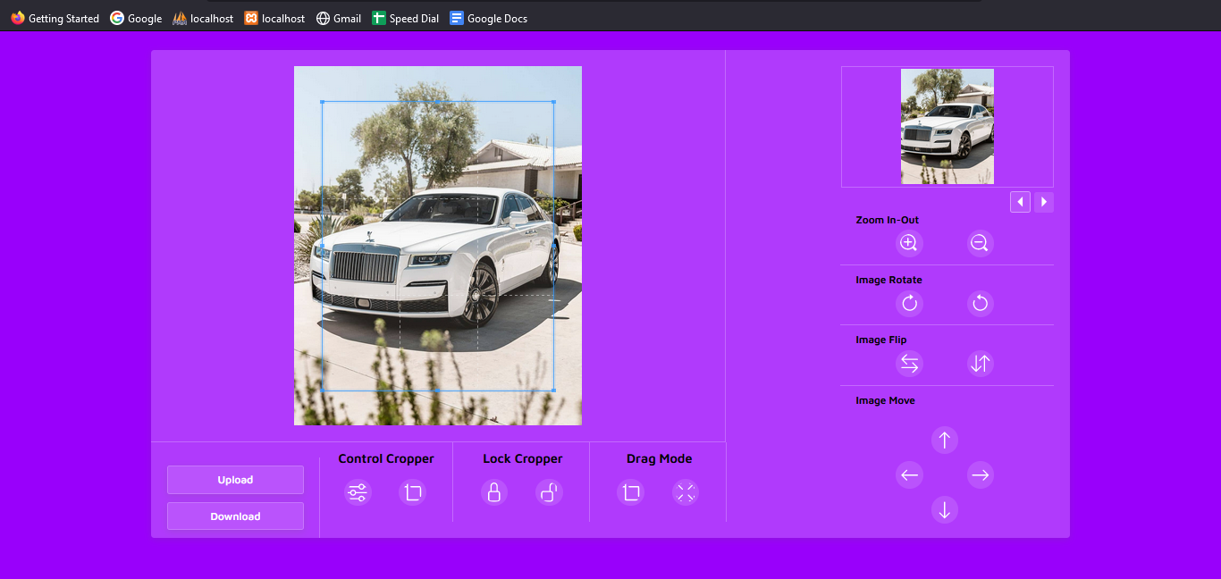
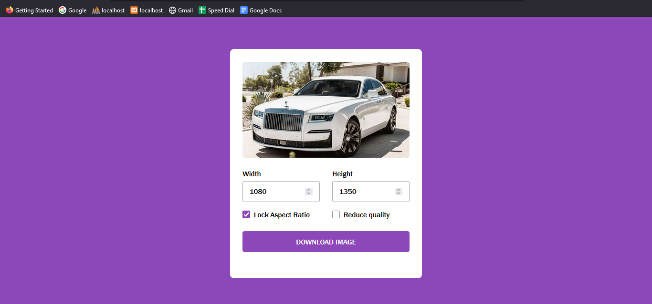
Screenshots
Img Cropper
Img Resizer

Slide 19
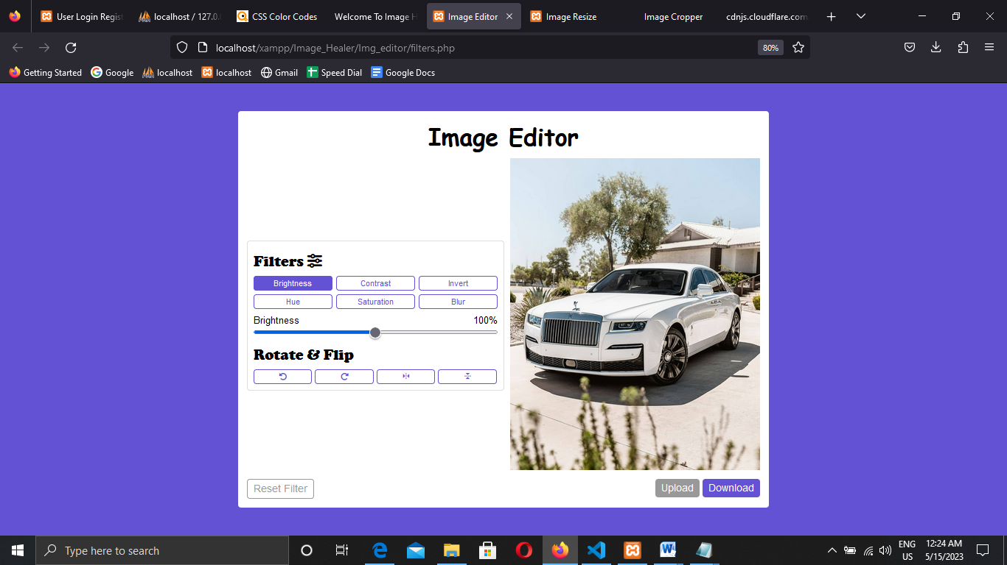
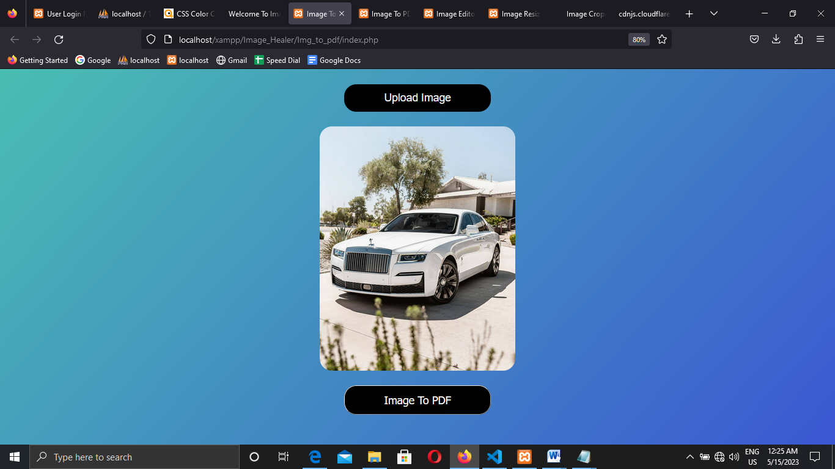
Screenshots
Filter Adjustments
Img To PDF Converter

Slide 20
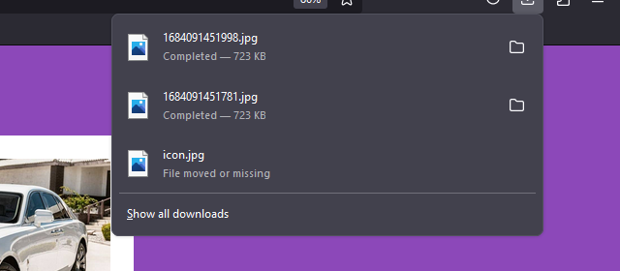
Screenshots
Download Images After Edit

Slide 21
Conclusion
In conclusion, an image healer tool that includes features such as cropper, filters, image to PDF conversion, compressor, and height and width changer is a powerful and versatile software application that enables users to perform a wide range of tasks related to image manipulation and management.
The development of an image healer tool with these features involves a range of activities, including requirements gathering, design, coding, testing, and deployment. These activities are typically performed by a team of developers, testers, and other professionals who work together to ensure that the tool meets the requirements and goals of the stakeholders.
An image healer tool with features such as cropper, filters, image to PDF conversion, compressor, and height and width changer is a powerful and versatile tool that can be useful in a range of industries, including photography, graphic design, and web development. The ongoing development and improvement of image healer tools with these features will continue to be an important area of focus for software developers and designers.

Slide 22
Future Enhancement
In the future, there are several enhancements that could be made to image healer tools that include cropper, filters, image to PDF conversion, compressor, and height and width changer features. Some potential enhancements could include:
Artificial intelligence (AI) features
Cloud-based services
Improved compression algorithms
Real-time collaboration
3D image editing

Slide 23
Thank You : )

